Slide 1
Logistic regression
Logistic Regression is a type of machine learning algorithm used for classification problems, not regression (despite the name).
It predicts a probability between 0 and 1, and is commonly used when the output is binary (e.g., Yes/No, Pass/Fail, 0/1, Spam/Not Spam).

Slide 2
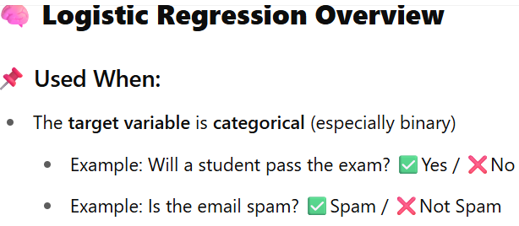
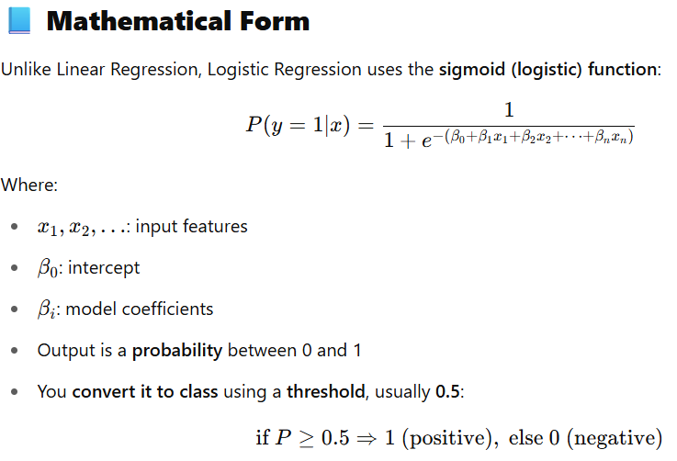

Slide 3
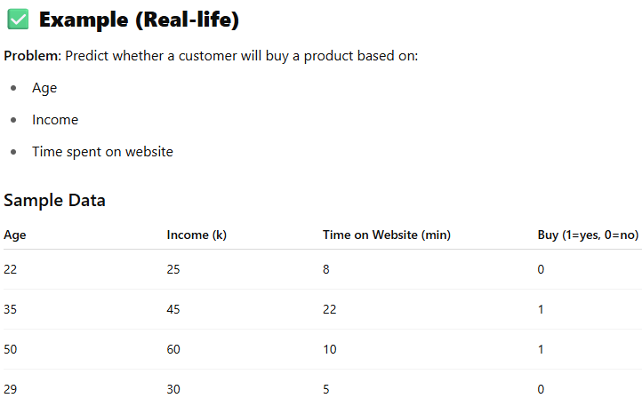
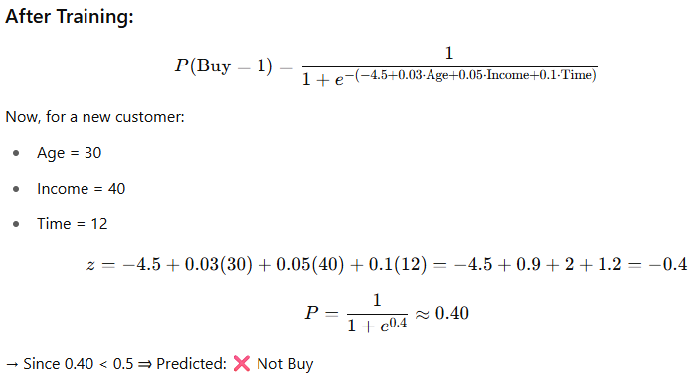

Slide 4
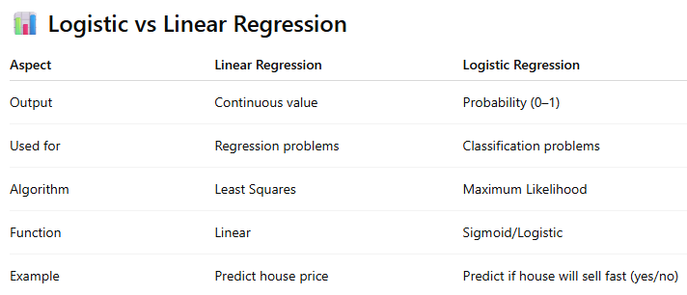

Slide 5
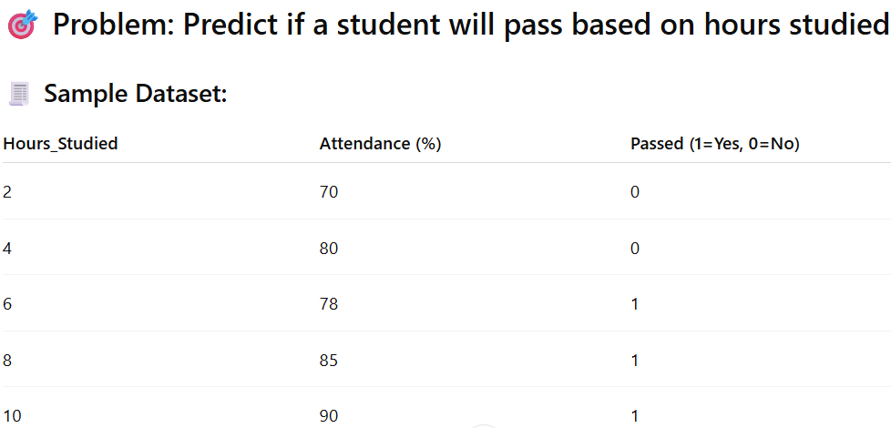
how to train a logistic regression model step by step using Python

Slide 6
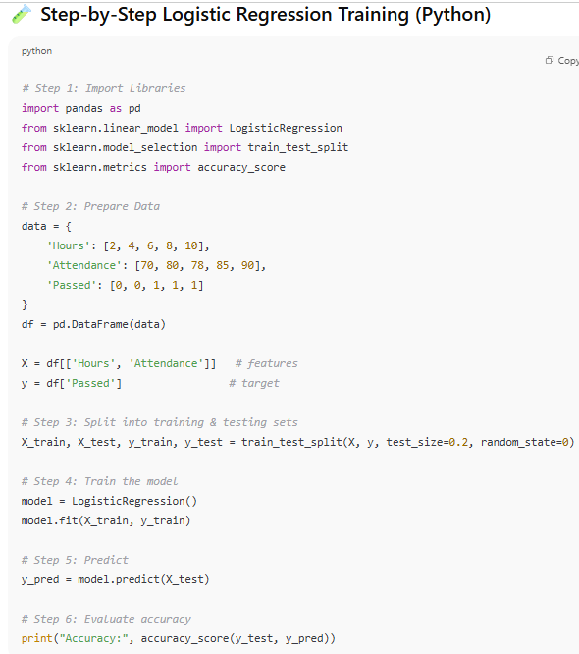
How to train a logistic regression model step by step using Python

Slide 7
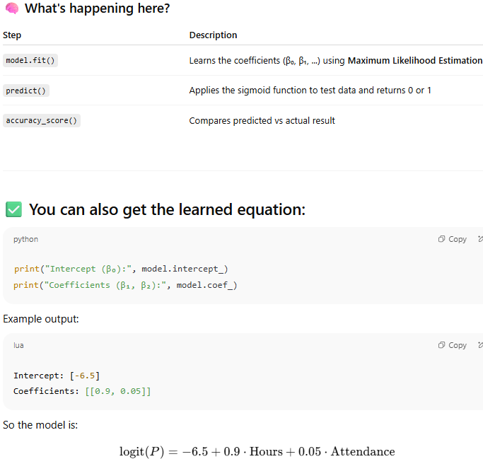
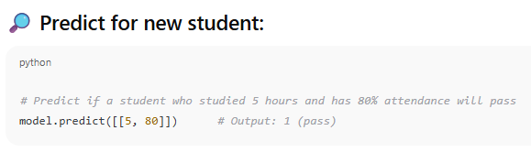
how to train a logistic regression model step by step using Python

